Slide 1

Message Construction
Systems Integration
PBA Softwareudvikling/BSc Software Development
Tine Marbjerg
Fall 2017
Message Construction

Slide 2
Message Issues
Message intent
  Command Message (145) invoke function
  Document Message (147) send data
  Event Message (151) send notification
Returning a response
  Request-Reply (154) want a reply
  Return Address (159) where to put reply
  Correlation Identifier (163) link request to reply by id
Large amounts of data
  Message Sequence (170) break data into manageable chunks
Slow messages
  Message Expiration (176) put deadline on time-sensitive messages
Design data format
  Format Indicator (180) specification of message format
Message Construction

Slide 3
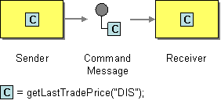
Command Message
Invoke functionality in other application
SOAP and WSDL example (EIP p. 146)
  RPC-style SOAP message is example of Command Message pattern
<soap:Envelope
xmlns:soap="http://schemas.xmlsoap.org/soap/envelope"
soap:encodingStyle="http://schemas.xmlsoap.org/soap/encoding">
<soap:Body>
<m:GetLastTradePrice xmlns:m=“Some-URI">
<symbol>DIS</symbol>
</m:GetLastTradePrice>
</soap:Body>
</soap:Envelope>
Message Construction

Slide 4

Document Message
Transfer data to other application
SOAP and WSDL example (EIP p. 150)
<soap:Envelope
xmlns:soap="http://schemas.xmlsoap.org/soap/envelope"
soap:encodingStyle="http://schemas.xmlsoap.org/soap/encoding">
<soap:Body>
<m:GetLastTradePriceResponse xmlns:m=“Some-URI">
<symbol>113.75</symbol>
</m:GetLastTradePriceResponse>
</soap:Body>
</soap:Envelope>
Message Construction

Slide 5
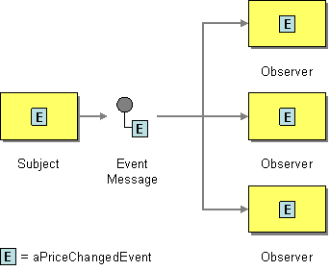
Event Message
Transmit event from one application to another
Many event msg. are empty; their mere occurrence tells the observer to react
Observer Pattern
The push model sends information about the change as part of the update
  combined Document/Event message
The pull model sends minimal information and observers can afterwards request state from the subject
  Event Message to notify observer about update
  Command Message send from observer to subject (state request)
  Document Message send from subject to observer (state reply)
Message Construction

Slide 6

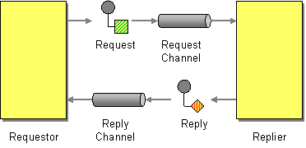
Request-Reply
When an application sends a message, how can it get a response from the receiver?
Send a pair of Request-Reply messages, each on its own channel
The request channel can be a Point-to-Point Channel or a Publish-Subscribe Channel
The reply channel is almost always point-to-point– the reply should only be returned to the requestor
Message Construction

Slide 7

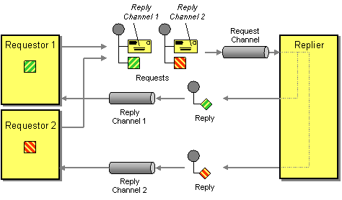
Return Address
How does a replier know where to send the reply?
The request message should contain a Return Address that indicates where to send the reply message.
Message Construction

Slide 8
JMS Return Address Example (EIP p. 161)
JMS Sender code
Queue requestQueue = // Specify request destination
Queue replyQueue = // Specify reply destination
Message requestMessage = // Create request message
requestMessage.setJMSReplyTo(replyQueue);
MessageProducer requestSender = session.createProducer(requestQueue);
requestSender.send(requestMessage);
JMS Receiver code
Queue requestQueue = // Specify request destination
MessageConsumer requestReceiver = session.createConsumer(requestQueue);
Message requestMessage = requestReceiver.receive();
Message replyMessage = // Create reply message
Destination replyQueue = requestMessage.getJMSReplyTo();
MessageProducer replySender = session.createProducer(replyQueue);
replySender.send(replyMessage);
Message Construction
Notes:
Note: Type is Destination (a Topic or Queue) rather than string for destination name, which ensures that the destination exists

Slide 9
.NET Return Address Example (EIP p. 161 c+ chap 6)
.NET Sender code
...
Message requestMessage = new Message();
requestMessage.Body = "Hello world";
requestMessage.ResponseQueue = replyQueue;
requestQueue.Send(requestMessage);
.NET Receiver code
...
MessageQueue replyQueue = requestMessage.ResponseQueue;
Message replyMessage = new Message();
replyMessage.Body = // specify message
replyQueue.Send(replyMessage);
Message Construction

Slide 10

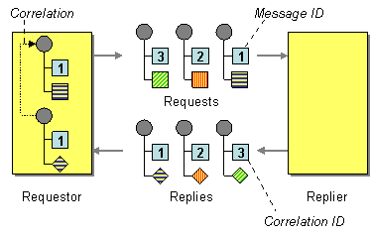
Correlation Identifier
How does a requestor that has received a reply know which request this is the reply for?
Each reply message should contain a Correlation Identifier, a unique identifier that indicates which request message this reply is for
Message Construction

Slide 11
JMS Correlation ID Example (EIP p. 167)
The replying message can use the requesting message’s message id as correlation id:
JMS Correlation ID code
Message requestMessage = // Get the request message
Message replyMessage = // Create the reply message
String requestID = requestMessage.getJMSMessageID();
replyMessage.setJMSCorrelationID(requestID);
.NET
Each message in .NET has a CorrelationId property
Message Construction

Slide 12

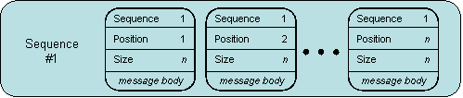
Message Sequence
How can messaging transmit an arbitrarily large amount of data?
Whenever a large set of data may need to be broken into message-size chunks, send the data as a Message Sequence and mark each message with sequence identification fields.
Message Construction
Notes:
MSMQ message size = 4MB

Slide 13

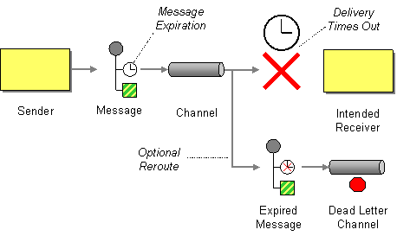
Message Expiration
How can a sender indicate when a message should be considered stale and thus shouldn’t be processed?
Set the Message Expiration time stamp on the message
  Like the expiration date on a milk carton ☺
Message Construction
Notes:
Msmq: The Message class has a TimeToBeReceived property

Slide 14
Format Indicator
How can a message’s data format be designed to allow for possible future changes?
Design a data format that includes a Format Indicator, so the message can specify what format it is using.
Enables the sender to tell the receiver the format of the message.
A receiver expecting several possible formats knows which one a message is using and therefore how to interpret the message’s contents.
Message Construction

Slide 15
Alternative Implementations
Version Number. Number or string that uniquely identifies the format
Foreign Key. Unique ID (filename, URL etc.) that specifies a format document
Format Document. Schema that describes the data format. Embedded in the message –not referenced by a number or a key
Version Number or Foreign Key can be stored in the header field and has to be agreed upon
Message Construction

Slide 16
Pros & Cons
Version number
  Pro: Don’t have to share repository
  Con: Each part must know what descriptor is indicated and where to access it
Foreign key
  Pro: Foreign key is compact
  Con: format document might need to be retrieved fro remote resource
Format Document
  Pro: messages are self-contained
  Con: Message traffic increases
Message Construction

Slide 17

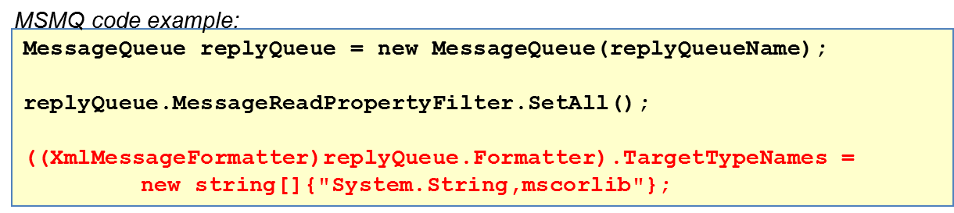
Simple MSMQ code example
Message Construction

Slide 18

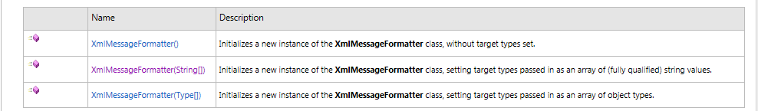
.NET Message Formatting Examples
IMessageFormatter produces a stream to be written to or read from the message body.
Examples
See: https://msdn.microsoft.com/en-us/library/system.messaging.messagequeue.formatter(v=vs.110).aspx
XML formatter on queue
myQueue.Formatter = new XmlMessageFormatter(new Type[]
{typeof(MyProject.Order)});
XML formatter on message
myMessage.Formatter = new XmlMessageFormatter(new String[]
{ "System.String,mscorlib" })
Message Construction
Notes:
http://msdn.microsoft.com/en-us/library/system.messaging.messagequeue.formatter.aspx
Example
Binary formatter on message
Message myMessage = new Message(myImage, new BinaryMessageFormatter());

Slide 19
MSMQ Messaging Demo + Exercise 1
Get some basic C# message code up running on your own computer:
  be able to send and receive messages from the same app on the same channel (dk: “hul igennem prototype”)
  see Demo.cs (C#-MSMQ example) on next slide for inspiration
  In VS project, you need to add reference to System.Messaging assembly (also remember “using …” in *.cs file)
  After having built and run your program:
    Find the queue that you created programmatically in your C# code via Windows computer administration under the Message Queuing service (see how on later slide)
  You must have MSMQ service up running on your computer (the Message Queuing component MSMQ is part of Windows
  operating system, but is not installed by default)
      Select Add or Remove Programs from the Control Panel (see more in Coffeeshop exercise, if your are in doubt about this).

Slide 20
using System;
using System.Messaging;
namespace QueueApplication
{ class Demo {
private MessageQueue mq;
private string myText = "Not initialized";
private void GetChannel(){
if (MessageQueue.Exists(@".\Private$\MyQueue1"))
mq = new System.Messaging.MessageQueue(@".\Private$\MyQueue1");
else mq = MessageQueue.Create(@".\Private$\MyQueue1");
Console.WriteLine(" Queue Created ");
}
private void Populate(){
Message msg = new System.Messaging.Message();
myText = "Body text";
msg.Body = myText;
msg.Label = "Tine Marbjerg";
mq.Send(msg);
Console.WriteLine(" Posted in MyQueue1");
}
private string GetResult(){
Message msg;
string str = "";
string label = "";
try {
msg = mq.Receive(new TimeSpan(0, 0, 50));
msg.Formatter = new XmlMessageFormatter(new String[] { "System.String,mscorlib" });
str = msg.Body.ToString();
label = msg.Label;
}
catch { str = " Error in GetResult()"; }
Console.WriteLine(" Received from " + label);
return str;
}
static void Main(string[] args) {
Demo d = new Demo();
d.GetChannel();
d.Populate();
string result = d.GetResult();
Console.WriteLine(" send: {0} ", d.myText);
Console.WriteLine(" receive: {0} ", result);
Console.ReadLine();
} } }
C# MSMQ example
I’m aware the code lacks line shifts here and there for readibility, but I wanted to squeeze it into one slide ☺

Slide 21
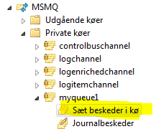
Computer Administration of Message Service
To see all message channels defined on your computer and how many messages they hold, do the following:
Right-click on "My Computer" and chose Manage
Expand the node "Services and Applications"
Expand the node "Message Queuing"
Expand the node "Private Queues“
Right-clicking on “Sæt beskeder i kø” shows all the messages in that particular queue (or you can empty the queue)
Messaging Channels

Slide 22
MSMQ Messaging Exercise 2
Make a Rock-paper-scissors game with two applications that represent each their hand.
The applications communicate via MSMQ.
You can use ”Player One” project for inspiration
  be aware that you need two components running – one for each hand
  Extra: It would be nice if the game can run in a loop and not just once (find inspiration for how to do that in exercise 3)

Slide 23
MSMQ Messaging Exercise 3
Implement publisher-subscriber pattern with Multicasting.
See example here:
https://www.codeproject.com/Articles/871746/Implementing-pub-sub-using-MSMQ-in-minutes

Slide 24
MSMQ Messaging Exercise 4A
Make an application that can put an Order object in a message and put it on a message queue.
You can specify a formatter on either the queue or the message.
XML formatter on queue
myQueue.Formatter = new XmlMessageFormatter(new Type[]
{typeof(MyProject.Order)});
XML formatter on message
myMessage.Formatter = new XmlMessageFormatter(new String[]
{ "System.String,mscorlib" })

Slide 25
MSMQ Messaging Exercise 4B
Make a request-reply messaging implementation using the following patterns (look for inspiration in EIP chap 6):
When an order message sent by client app is received by order app, the order app sends response with delivery time. The client app picks up answer on reply channel and outputs the delivery time on the screen. You need min. two queues ☺
  Return Address
  Correlation-id
  Format Indicator
  Request-reply
  specify reply channel on request message
  specify id on reply message for identification
  Specify data format on message
  Receiver app and Reply app must run as two separate components.
Message Construction

